Slide 1
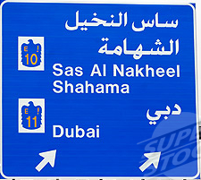
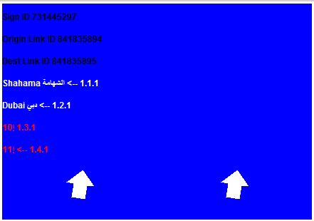
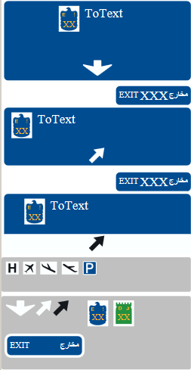

AE (United Arabian Emirates) 24.48332 / 54.65212
Photo
Core map sign content 2012Q3
GMS template 2012Q2
GJV+GMS generated by RDFViewer Release 20120922
SON_A
EXIT_A_R
EXIT_B_R

Slide 2
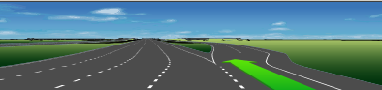
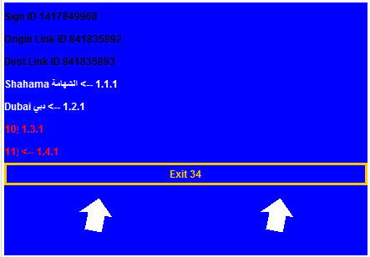
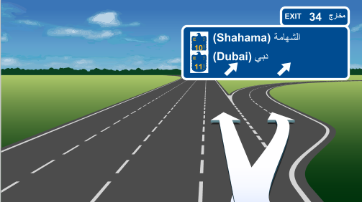
AE (United Arabian Emirates) 24.48195 / 54.65798
EJV 2012Q2
Core map sign content 2012Q3
GMS template 2012Q2
GJV+GMS generated by RDFViewer Release 20120922
SON_A
EXIT_A_R
EXIT_B_R

Slide 3

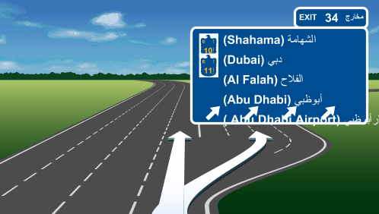
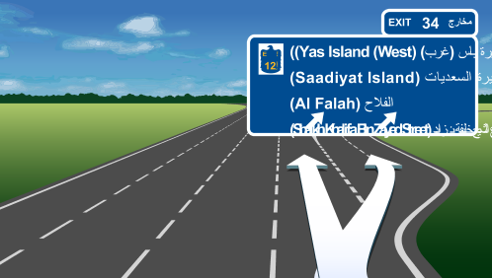
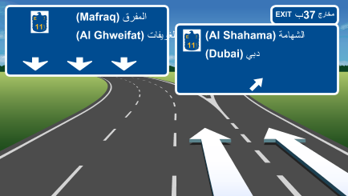
AE (United Arabian Emirates) more examples 2012Q2
24.55870 54.69592
24.48651 54.63636
24.47372 54.63553
24.41044 54.68156

Slide 4
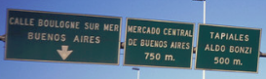
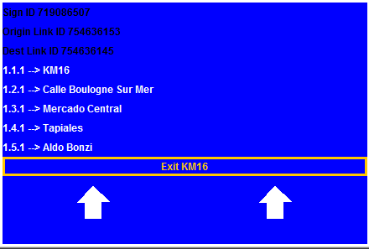
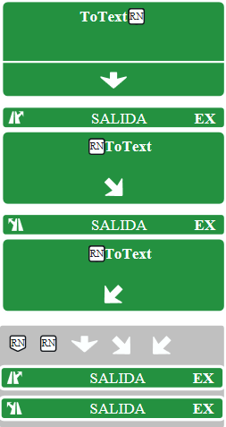
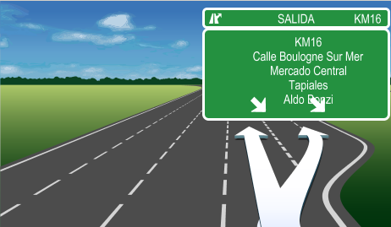
AR (ARGENTINA) -34.70537 / -58.50029
Photo
Core map sign content 2012Q3
GMS template 2012Q3
GJV+GMS generated by RDFViewer Release 20120925
SON_A
EXIT_A_R
EXIT_A_L

Slide 5
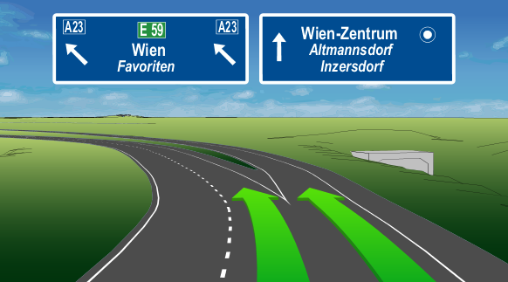
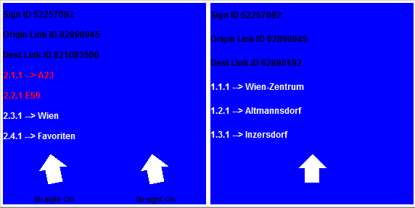
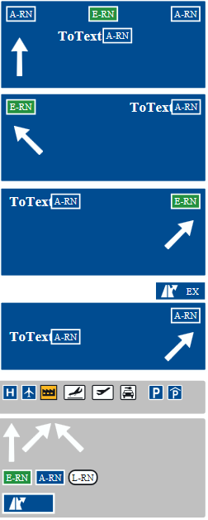
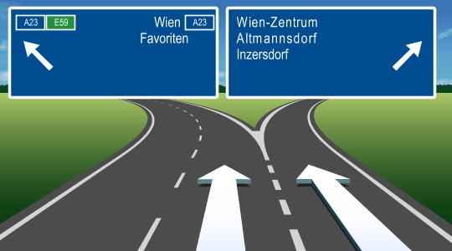
AT (AUSTRIA) 48.11972 / 16.32736
EJV 2012Q2
Core map sign content 2012Q3
SON_A
GJV+GMS generated by RDFViewer Release 20120921
BIF_A_L
BIF_A_R
EXIT_A_R
GMS template 2012Q3

Slide 6
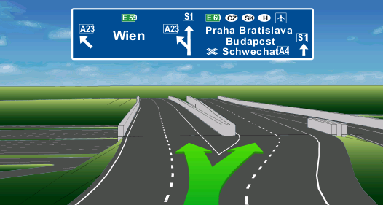
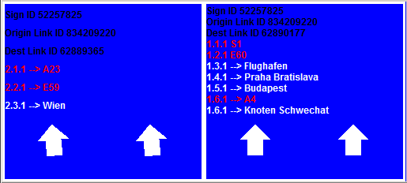
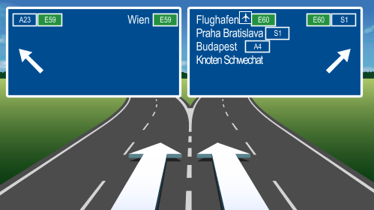
AT (AUSTRIA ) 48.11925 / 16.32337
EJV 2012Q2
Core map sign content 2012Q3
SON_A
GJV+GMS generated by RDFViewer Release 20120921
BIF_A_L
BIF_A_R
EXIT_A_R
GMS template 2012Q3

Slide 7
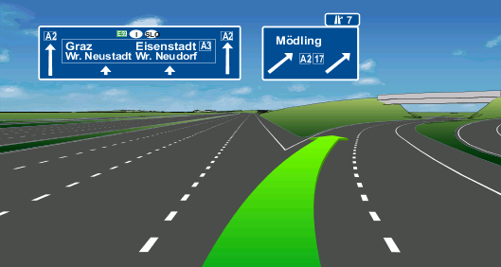
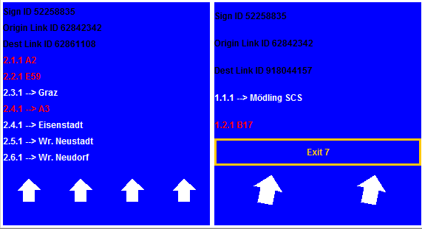
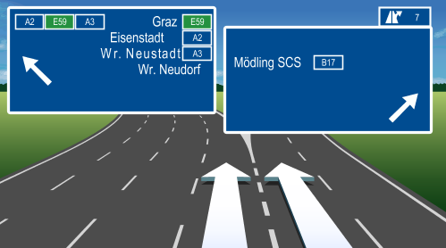
AT (AUSTRIA ) 48.11899 / 16.32395
EJV 2012Q2
Core map sign content 2012Q3
SON_A
GJV+GMS generated by RDFViewer Release 20120921
BIF_A_L
BIF_A_R
EXIT_A_R
GMS template 2012Q3

Slide 8
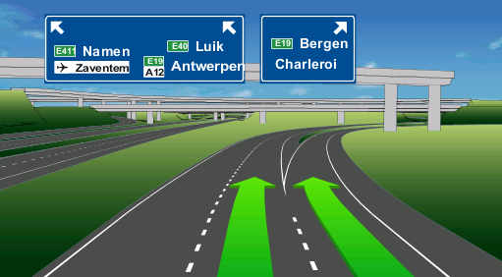
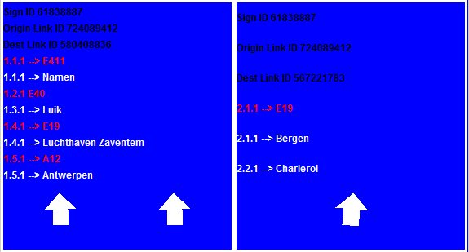
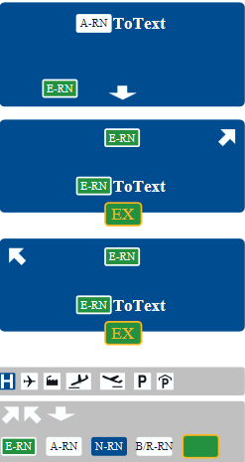
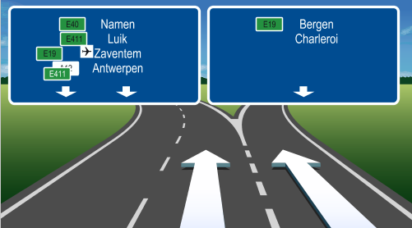
BE (Belgium) 50.87726 / 4.26886
EJV 2012Q2
Core map sign content 2012Q3
GMS template 2012Q3
GJV+GMS generated by RDFViewer Release 20120921
SON_A
BIF_A_R
BIF_A_L

Slide 9
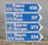
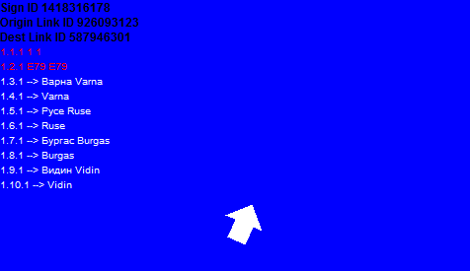
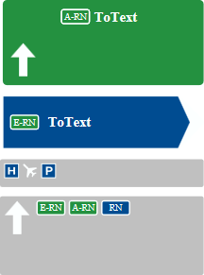
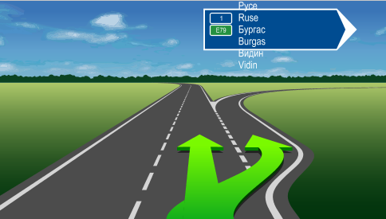
BG (Bulgaria) 42.70496 / 23.45074
EJV 2013Q2
Core map sign content 2013Q2
GMS template 2013Q2
GJV+GMS generated by RDFViewer Release 20130613
SON_A
EXIT_A_R

Slide 10
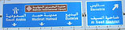
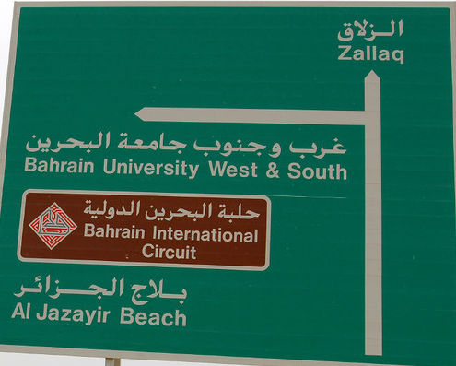
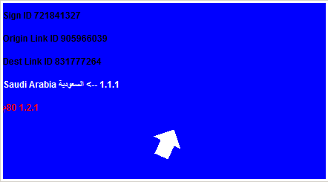
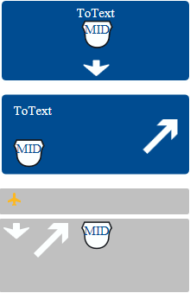
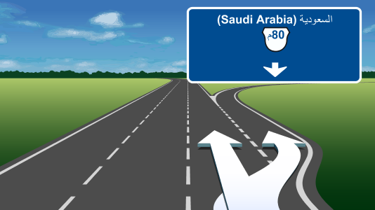
BH (Bahrain) 26.19481 / 50.50617
Example Photos
Core map sign content 2012Q3
GMS template 2012Q2
GJV+GMS generated by RDFViewer Release 20121020
SON_A
EXIT_A_R

Slide 11
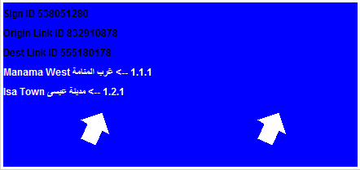
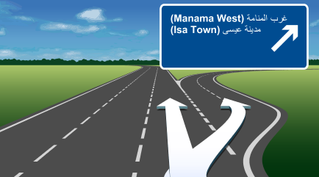
BH (Bahrain) 26.19642 / 50.53893
Example Photos
Core map sign content 2012Q3
GMS template 2012Q2
GJV+GMS generated by RDFViewer Release 20121020
SON_A
EXIT_A_R

Slide 12
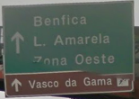
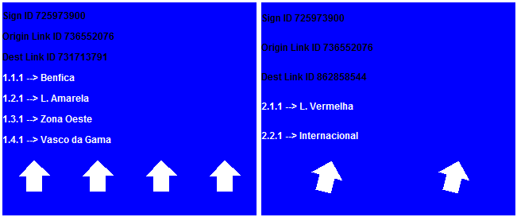
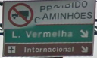
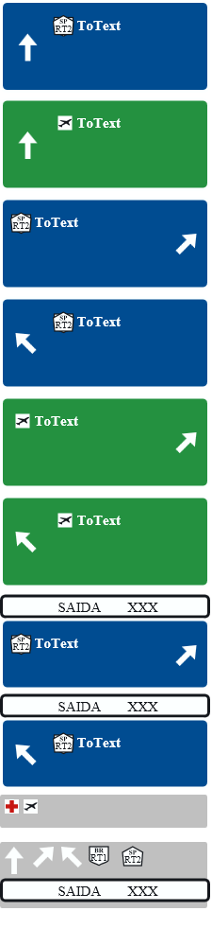
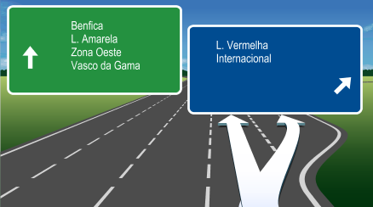
BR (Brazil) -22.88579 / -43.22532
Photo
Core map sign content 2012Q3
GMS template 2012Q3
SON_A
SON_B
BIF_A_R
GJV+GMS generated by RDFViewer Release 20120921
BIF_A_L
BIF_B_R
BIF_B_L
EXIT_A_R
EXIT_A_L

Slide 13
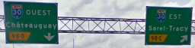
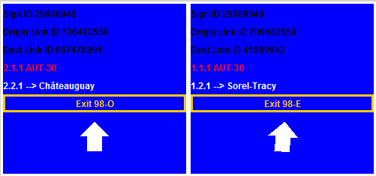
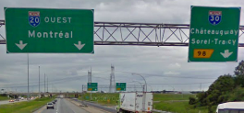
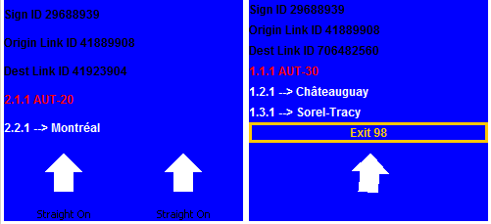
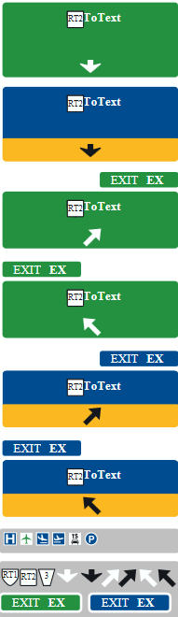
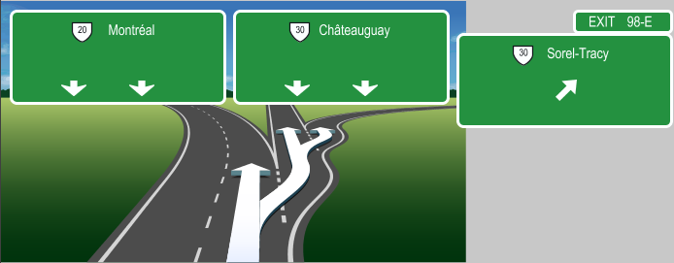
CA (Canada) 45.57546 / -73.36274
Core map sign content 2012Q3
Photo
GMS template 2012Q3
SON_A
SON_B
GJV+GMS generated by RDFViewer Release 20121124
EXIT_A_R
EXIT_A_L
EXIT_B_R
EXIT_B_L
Multi Decision Point Situation

Slide 14
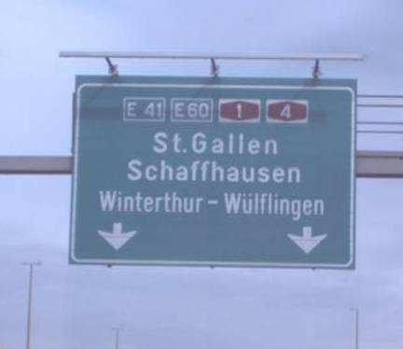



CH (Switzerland) 47.47624 / 8.70509
Photo
Core map sign content 2012Q3
GMS template 2012Q3
GJV+GMS generated by RDFViewer Release 20120924
SON_A
EXIT_A_R
EXIT_B

Slide 15




CL (Chile) -33.52199 / -70.69965
Photo (different location)
Core map sign content 2013Q1
GMS template 2013Q1
SON_A
EXIT_A_R
GJV+GMS generated by RDFViewer Release 20130328
EXIT_A_L
EXIT_B_R
EXIT_B_L

Slide 16




CO (Colombia) 4.60990 / -74.06835
Photo (different location)
Core map sign content 2013Q1
GMS template 2013Q1
SON_A
BIF_A_R
BIF_A_L
GJV+GMS generated by RDFViewer Release 20130328
EXIT_A_R
EXIT_A_L
EXIT_B_R
EXIT_B_L

Slide 17




CZ (Check Republic) 50.09908 / 14.59817
Photo
Core map sign content 2012Q3
GMS template 2012Q3
GJV+GMS generated by RDFViewer Release 20121003
SON_A
BIF_A_L
BIF_A_R
EXIT_A_R

Slide 18




DE (Germany) 50.12763 / 8.57606
EJV 2012Q2
Core map sign content 2012Q3
GMS template 2012Q3
GJV+GMS generated by RDFViewer Release 20120921
SON_A
BIF_A_L
BIF_A_R

Slide 19



DE (Germany) 50.06467 / 8.73206
EJV 2012Q2
Core map sign content 2012Q3
GMS template 2012Q3
GJV+GMS generated by RDFViewer Release 20120921
SON_A
BIF_A_L
BIF_A_R

Slide 20




DE (Germany) 50.12900 / 8.56703
EJV 2012Q2
Core map sign content 2012Q3
GMS template 2012Q3
GJV+GMS generated by RDFViewer Release 20120924
SON_A
BIF_A_L
BIF_A_R
Multi Decision Point Situation

Slide 21




DK (Danmark) 55.63358 / 12.66382
Photo
Core map sign content 2012Q3
GMS template 2012Q3
GJV+GMS generated by RDFViewer Release 20121103
SON_A
EXIT_A_R

Slide 22



DK (Danmark) 55.62674 / 12.43779
Photo
Core map sign content 2012Q3
GMS template 2012Q3
GJV+GMS generated by RDFViewer Release 20121103
SON_A
EXIT_A_R

Slide 23




EG (Egypt) 29.37229 / 31.30960
Photo (from a different location!)
Core map sign content 2012Q3
GMS template 2012Q3
GJV+GMS generated by RDFViewer Release 20121103
SON_A
BIF_A_R
BIF_A_L
EXIT_A_R

Slide 24




ES (Spain) 40.42080 / -3.72299
Photo
Core map sign content 2012Q4
GMS template 2012Q4
SON_A
GJV+GMS generated by RDFViewer Release 20130228
EXIT_A_R
EXIT_A_L
EXIT_B_R
EXIT_B_L

Slide 25




FI (Finland) 60.20816 / 24.80679
Photo
Core map sign content 2012Q4
GMS template 2012Q4
GJV+GMS generated by RDFViewer Release 20130214
SON_A
EXIT_A
EXIT_B

Slide 26




FR (France) 49.02080 / 1.51134
Photo
Core map sign content 2012Q3
GMS template 2012Q3
SON_A
GJV+GMS generated by RDFViewer Release 20121107
EXIT_A_L
EXIT_A_R
EXIT_B

Slide 27




GB (United Kingdom) 50.06467 / 8.73206
Photo
Core map sign content 2012Q3
GMS template 2012Q3
GJV+GMS generated by RDFViewer Release 20120921
SON_A
BIF_A_L
EXIT_A_R
EXIT_A_L

Slide 28




GR (Greece) 38.19108 / 21.71704
Photo
Core map sign content 2012Q3
GMS template 2012Q3
GJV+GMS generated by RDFViewer Release 20120921
SON_A
BIF_A_R
BIF_A_L
EXIT_A_R

Slide 29



GR (Greece) 39.57430 / 22.48418
Photo
Core map sign content 2012Q3
GMS template 2012Q3
GJV+GMS generated by RDFViewer Release 20121112
SON_A
BIF_A_R
BIF_A_L
EXIT_A_R

Slide 30




HR (Croatia) 45.78677 / 15.85561
Photo
Core map sign content 2012Q4
GMS template 2012Q4
GJV+GMS generated by RDFViewer Release 20130311
SON_A
BIF_A_R
EXIT_A_R

Slide 31





HU (Hungary) 47.57035 / 19.16282
Photo (from a different location)
Core map sign content 2012Q4
GMS template 2012Q4
GJV+GMS generated by RDFViewer Release 20130228
SON_A
EXIT_A_R

Slide 32




IE (Ireland) 53.39707 / -6.23851
Photo
Core map sign content 2012Q3
GMS template 2012Q3
GJV+GMS generated by RDFViewer Release 20121125
SON_A
EXIT_A_L

Slide 33




IL (Israel) 32.01051 / 34.81483
Photo
Core map sign content 2012Q4
GMS template 2012Q4
GJV+GMS generated by RDFViewer Release 20130311
SON_A
EXIT_A_R

Slide 34





IN (India) 13.00731 / 80.20317
EJV + SaR 2012Q4 (different locations)
Core map sign content 2012Q4
GMS template 2013Q1
SON_A
GJV+GMS generated by RDFViewer Release 20130308
SON_B
BIF_A_R
BIF_A_L
EXIT_A_R
EXIT_A_L
EXIT_B_R
EXIT_B_L
EXIT_C_R
EXIT_C_L

Slide 35




IT (Italy) 45.41464 / 10.91423
Photo
Core map sign content 2012Q3
GMS template 2012Q3
GJV+GMS generated by RDFViewer Release 20121013
SON_A
EXIT_A_R
EXIT_B

Slide 36




KW (Kuwait) 29.02339 / 48.09239
Photo
Core map sign content 2012Q3
GMS template 2012Q3
GJV+GMS generated by RDFViewer Release 20121213
SON_A
EXIT_A_R

Slide 37




LI (Lithuania) 55.46393 / 22.68922
Photo (nearby location but not identical)
Core map sign content 2013Q2
GMS template 2013Q2
GJV+GMS generated by RDFViewer Release 20130828
SON_A
EXIT_A_R

Slide 38




LU (Luxembourg) 49.57798 / 6.11409
Photo (different location)
Core map sign content 2012Q4
GMS template 2012Q4
GJV+GMS generated by RDFViewer Release 20130326
SON_A
BIF_A_R
BIF_A_L
EXIT_A_R

Slide 39




MA (Morocco) 33.50194 / -7.68303
Photo (different location)
Core map sign content 2012Q4
GMS template 2012Q3
GJV+GMS generated by RDFViewer Release 20130228
SON_A
BIF_A_R
BIF_A_L
EXIT_A_R

Slide 40




MX (Mexico) 20.65440 / -101.28888
Photo (from a different location!)
Core map sign content 2012Q3
GMS template 2012Q3
SON_A
GJV+GMS generated by RDFViewer Release 20121213
BIF_A_R
BIF_A_L
EXIT_A_R
EXIT_A_L

Slide 41




NO (Norway) 58.17403 / 8.10905
Photo
Core map sign content 2012Q3
GMS template 2012Q3
GJV+GMS generated by RDFViewer Release 20121013
SON_A
EXIT_A_R

Slide 42




OM (Oman) 23.59402 / 58.25057
Photo (different location)
Core map sign content 2012Q4
GMS template 2012Q4
GJV+GMS generated by RDFViewer Release 20130311
SON_A
EXIT_A_R

Slide 43




PL (Poland) 52.19050 / 20.78808
Photo (different location!)
Core map sign content 2012Q4
GMS template 2012Q4
GJV+GMS generated by RDFViewer Release 20130214
SON_A
EXIT_A_R

Slide 44




PR (Puerto Rico) 18.44825 / -66.06083
Photo
Core map sign content 2012Q4
GMS template 2012Q4
GJV+GMS generated by RDFViewer Release 20130129
SON_A
EXIT_A_R
EXIT_A_L

Slide 45




PT (Portugal) 38.71908 / -9.17604
Photo
Core map sign content 2013Q2
GMS template 2013Q2
GJV+GMS generated by RDFViewer Release 20130613
SON_A
SON_B
EXIT_A_R
EXIT_A_L
EXIT_B_R
EXIT_B_L

Slide 46




QA (Qatar) 25.25689 / 51.50286
Photo (different location)
Core map sign content 2012Q4
GMS template 2012Q4
GJV+GMS generated by RDFViewer Release 20130129
SON_A
EXIT_A_R

Slide 47




RO (Romania) 44.43699 / 25.95719
Photo (different location)
Core map sign content 2012Q4
GMS template 2012Q4
GJV+GMS generated by RDFViewer Release 20130312
SON_A
EXIT_A_R

Slide 48




RU (Russia) 55.70344 / 37.61656
Photo
Core map sign content 2012Q3
GMS template 2012Q3
GJV+GMS generated by RDFViewer Release 20121003
SON_A
BIF_A_R
BIF_A_L

Slide 49





SA (Saudi Arabia) 24.58564 / 46.71003
Photo
Core map sign content 2012Q4
GMS template 2012Q4
GJV+GMS generated by RDFViewer Release 20130214
SON_A
EXIT_A_R
+
EXIT_A_L

Slide 50




SE (Sweden) 57.71809 / 11.99238
Photo
Core map sign content 2012Q4
GMS template 2012Q4
GJV+GMS generated by RDFViewer Release 20130117
SON_A
EXIT_A_R

Slide 51




SK (Slovakia) 48.12093 / 17.07794
Photo
Core map sign content 2013Q2
GMS template 2013Q2
GJV+GMS generated by RDFViewer Release 20130828
SON_A
BIF_A_L
BIF_A_R
EXIT_A_R

Slide 52




SI (Slovenia) 45.69468 / 13.97951
Photo
Core map sign content 2013Q2
GMS template 2013Q2
GJV+GMS generated by RDFViewer Release 20130828
SON_A
EXIT_A_R
EXIT_B

Slide 53





TR (Turkey) 41.06115 / 28.80656
Just some general example photos!
Core map sign content 2012Q3
GMS template 2012Q3
GJV+GMS generated by RDFViewer Release 20121004
SON_A
EXIT_A_R

Slide 54




TW (Taiwan) 24.89545 / 121.26581
Photo
Core map sign content 2012Q4
GMS template 2012Q4
SON_A
GJV+GMS generated by RDFViewer Release 20121130
EXIT_A_R
EXIT_A_L
EXIT_B_R
EXIT_B_L

Slide 55




UA (Ukraine) 50.45546 / 30.35500
Photo
Core map sign content 2013Q2
GMS template 2013Q2
GJV+GMS generated by RDFViewer Release 20130828
SON_A
BIF_A_R
BIF_A_L

Slide 56




US (USA) 41.86598 / -87.64430
Photo
Core map sign content 2012Q3
GMS template 2012Q3
GJV+GMS generated by RDFViewer Release 20120924
SON_A
EXIT_A_R
EXIT_A_L

Slide 57




UY (Uruguay) -34.85578 / -56.26010
Photo (different location)
Core map sign content 2013Q2
GMS template 2013Q2
SON_A
BIF_A
GJV+GMS generated by RDFViewer Release 20130613
EXIT_A_R
EXIT_A_L
EXIT_B_R
EXIT_B_L
EXIT_C_R
EXIT_C_L

Slide 58




ZA (South Africa) -33.99246 / 18.49054
Photo
Core map sign content 2012Q3
GMS template 2012Q3
GJV+GMS generated by RDFViewer Release 20121003
SON_A
EXIT_A_L
EXIT_A_R

